Slide 1
Cognitive dissonance
Presented By: Zainab Agha
Rohab Latif
Shazia Bashir
Farhana Ayub
Sadia Sarwar

Slide 2
Cognitive Dissonance
Cognitive dissonance refers to the feelings of discomfort that arise when a person’s behavior or attitude is in conflict with the person’s values and beliefs.
The uncomfortable feeling caused by cognitive dissonance might manifest itself as stress, anxiety, regret, shame, embarrassment, or feelings of negative self-worth.

Slide 3
Cognitive Dissonance
The first person to investigate cognitive dissonance was a psychologist known as Leon Festinger. According to him, if a person holds two beliefs that are relevant to one another but are inconsistent, dissonance will arise.
According to Marcia Gruber (2003), “Dissonance refers to the personal tension or stress experienced when an individual’s actions contradict or are inconsistent with his or her values or beliefs” (p. 242).

Slide 4
Cognitive Dissonance
For Instance, the smoker knows that smoking is bad and yet loves smoking, he tries to change his beliefs by convincing himself that smoking is not that bad.

Slide 5
Cognitive Dissonance

Slide 6
Causes of cognitive dissonance
Forced Compliance Behavior:
Example
Forced compliance behavior refers to situations where a person is forced to perform actions that are not consistent with his or her beliefs.
Consider an accountant who is told to cover up an instance of financial misappropriation by her boss. The accountant believes this is wrong, yet she might be forced to do it in order to retain her job.
This leads to cognitive dissonance.

Slide 7
Decision Making:
Example
Decisions are part of life. You have to make hundreds of decisions to get through each day. What you may not know is that decision making arouses dissonance as a general rule. This is because all decisions involve choosing between two or more alternatives. Each alternative has its pros and cons.
Let’s assume you have to choose between two jobs. One job is located in a third world country, but the pay is quite good. The other job is in your hometown, but the pay is not really what you would have wished for. If you take the job in the third world country, you will earn enough money in a few years to allow you buy to your dream home, but you will be away from your family and friends. If you take the job closer to home, you will be around your family and friends, but you won’t be able to afford your dream home.

Slide 8
Effort
Humans have a tendency to value achievements based on the amount of effort it took to achieve them. A person who had to save for 10 years to buy a Ferrari will value it more than that young man who made millions from cryptocurrencies within four months and bought himself a similar Ferrari.
Things that take considerable effort are valued higher because we would experience dissonance if we spent a great deal of effort only to make a minor achievement.
Example
A person who had to save for 10 years to buy a Ferrari will value it more than that young man who made millions from crypto currencies within four months and bought himself a similar Ferrari.

Slide 9
Gaining New Information
Example
Another major cause of cognitive dissonance is coming across information that goes against our beliefs.
Let’s consider the example of Festinger’s cultists from the 1950s. These group of people believed that there would be a flood and that a flying saucer would come to their rescue. Come the morning of 21st December, there was neither a flood nor a UFO. This new information was against their beliefs, resulting in cognitive dissonance.

Slide 10
FACTORS INFLUENCING COGNITIVE DISSONANCE
The degree of cognitive dissonance experienced by a person varies depending on the particular situation that caused the dissonance and the circumstances surrounding the situation. The intensity of the cognitive dissonance experienced is generally affected by the following factors:

Slide 11
Personal Cognitions
Personal cognitions, such as beliefs about self and personal values result in a higher degree of cognitive dissonance. People don’t like looking dumb, dishonest or unethical, therefore they will be very uncomfortable about any dissonance that threatens their self-image.
The importance of the cognition. Generally, if the belief or value is highly valued, then the resulting dissonance will be stronger.

Slide 12
The disparity between the consonant belief and the dissonant
The disparity between the consonant (harmonious) belief and the dissonant (conflicting) thoughts, action or information. The greater the disparity, the greater the dissonance.
The possibility of explaining the dissonance in other ways. If there are multiple ways for explaining away the dissonance, then the intensity of the dissonance will be minimized.

Slide 13
The ramifications of the decision
The ramifications of the decision, as well as the ease with which the consequences of the decision can be undone. Permanent decisions with significant ramifications tend to cause stronger dissonance.
These factors determine the influence the dissonance and the lengths to which we will go to reduce or eliminate the discomfort. The stronger the dissonance, the more pressure there is to reduce the tension.

Slide 14
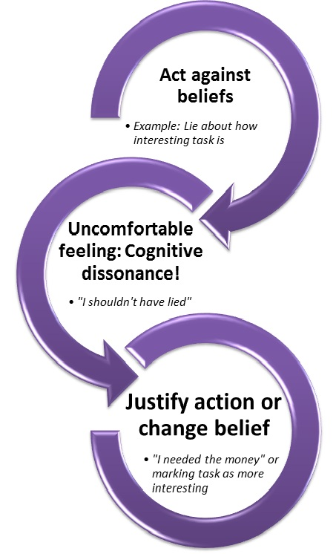
RECOGNIZATION OF COGNITIVE DISSONANCE
SQUAEMISHNESS (FEELING OF UNCOMFORTABLENESS)
Feeling squeamish- the uncomfortable feeling in the pit of your stomach is a sure sign that you may be dealing with cognitive dissonance.
The benefits of not signing a new contract right away directly conflicted with my strong desire to buy the coolest new technology. BlackBerry had so many cool features that it was worth it (somewhat true). That rationalization was all I needed to resolve the issue between those two thoughts, and two days later I was setting up my new phone.
AVOIDANCE (Avoiding conflict):
This stage of cognitive dissonance comprises of avoiding the conflict, conflicting thoughts and ways and choosing the easy path for proceeding.

Slide 15
RECOGNIZATION OF COGNITIVE DISSONANCE
IGNORING THE FACTS:
As we are avoiding making tough decisions, this can cause us to put on blinders and not examine the data because it can be very painful.
A person is ignoring the facts and focusing on doing what he finds right hence lacks behind and possess cognitive dissonance.
TALKING YOURSELF OF THE LEDGE (RATIONALIZATION):
Another sign that you may be experiencing cognitive dissonance is the rationalization chatter that you are having with yourself. Basically, it’s the concept of convincing yourself that you made a good decision when you changed your mind about a belief that you had.

Slide 16
DEER EYES (Fear of missing out)
Another common sign of cognitive dissonance is what I call ‘deer eyes’. Essentially, your eyes get big and wide. You get really super excited that you follow the herd. Some folks follow others like them and it typically involves money.
SHAME:
The feeling of shame after doing a particular thing is also the part of cognitive dissonance.
GUILT
The feeling of guilt after doing something you are not desired to do leads you towards cognitive dissonance and you feel guilt of going against your structured thought and ideas.

Slide 17
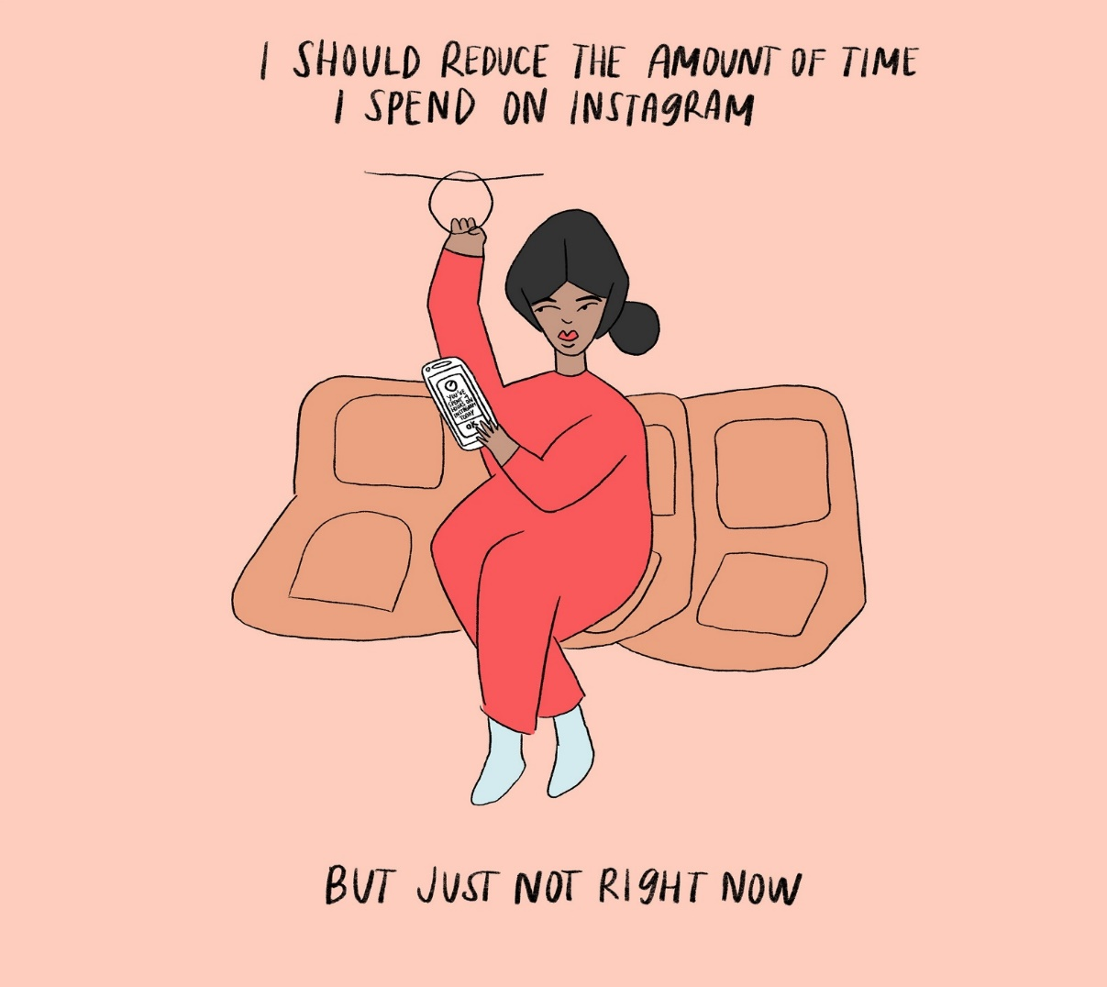
To Reduce cognitive dissonance
This resolution will happen in one of three basic ways:
Change one or more of the attitudes, behavior, belief etc. to make the relationship between the two elements a consonant one. When one of the dissonant elements is a behavior, the individual can change or eliminate behavior. However, this mode of dissonance reduction frequently presents problems for people, as it is often difficult for people to change well learned behavioral responses (e.g. giving up smoking)

Slide 18
To Reduce cognitive dissonance
Acquire new information that outweighs the dissonant beliefs for example thinking smoking causes lung cancer will cause dissonance if a person smokes. However new information such as research has not proved definitely that smoking causes lung cancer may reduce the dissonance.

Slide 19
To Reduce cognitive dissonance
Reduce the importance of the cognitions (i.e., belief, attitudes). A person could convince themselves that it is better to live for today than to save for tomorrow. In other words, he could himself that a short life filled with smoking and sensual pleasures is better than a long life devoid of such joys. in this way, he would be decreasing the importance of the dissonant cognition (smoking is bad for one’s health).

Slide 20
Conclusion
Cognitive dissonance is when a person has two contradicting beliefs leading them to become distressed and motivated to reach consonance again. In order to reach stability a person will either change their beliefs, behaviors or add new beliefs. According to cognitive dissonance, people will avoid anything that increases dissonance for them. People are most comfortable at a stable state and anything that disrupts this causes a great deal of stress, so avoidance or changes are made to get back to consonance.

